Slide 1
Setting up your student AP Classroom
Verify your student ID, School name, join AP classroom and make an exam decision

Slide 2
If you cannot log into your “My AP” account
You must call College Board and speak to them about helping you with your login issues
1-833-315-6068 is the student account number

Slide 3
Log in with your College Board account
Verify your student ID number is correct in your AP Profile.
DO NOT GO TO YOUR COLLEGE BOARD SETTINGS!
You need to verify your ID in your AP Profile –

Slide 4
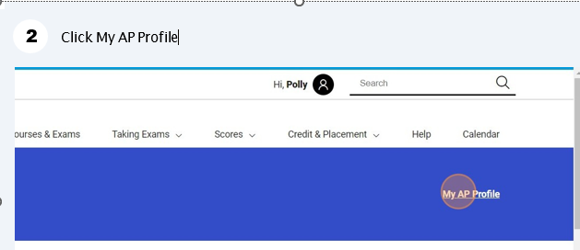
Login using : http://apstudents.collegeboard.org

Slide 5
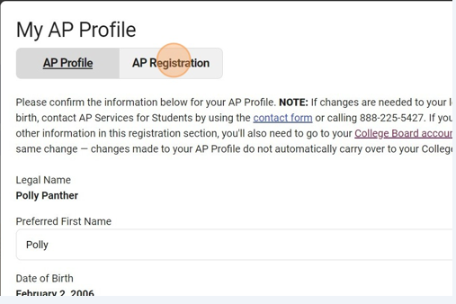
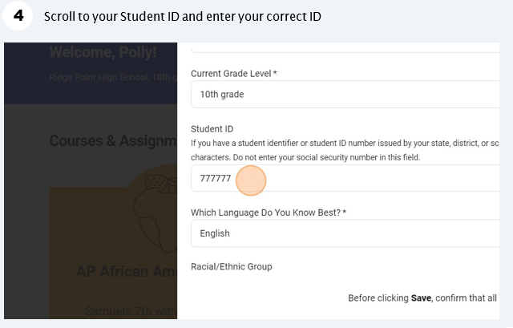
My AP Profile click on “AP Profile” – scroll down to ID and verify the ID is correct

Slide 6
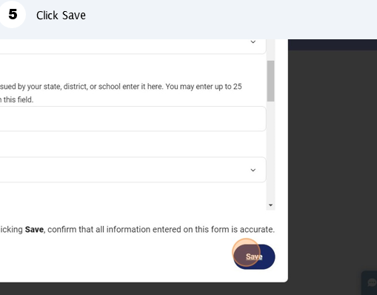
CLICK SAVE!!!

Slide 7
Verify your school is correct – many are NOT!
Go back to “My AP Profile and click on “AP Registration”

Slide 8
Update School
School is commonly incorrect
Scroll down and update “Dulles High School”
CLICK SAVE!!!!

Slide 9

Join your AP Classroom
Every AP Teacher has their own join code for each AP class/period they teach
Login in to My AP with your College Board login information
Scroll down and click on “Join a Course or Exam” button
Enter the join code
Click submit

Slide 10
How to choose your “Order Exam?” status
Log into “My AP” with your College Board login information
Go to “My AP Classroom”
There is a dropdown option next to each exam, choose “yes” or “No”
Your test cannot be left “Undecided”

